Slide 1

Research Seminar Project
Lebedev Maxim, Kadetov Alexey, Davydova Darya, Ukhobotova Lilia, Kerber Ekaterina, Inchenko Ilona, Lata Maxim, Dorofeev Alexander
BASB211

Slide 2
Background
To outsiders, warehousing often looks straightforward — just store products on racks until they’re needed, but industry insiders can only wish that it was that simple! Managing inventory has always been challenging, and trends in logistics management continue to make it harder every day.
Most of the problems could be narrowed to:
1. Inaccurate Inventory
2. Poor Layout/Space Utilization
3. High Labor Costs

Slide 3

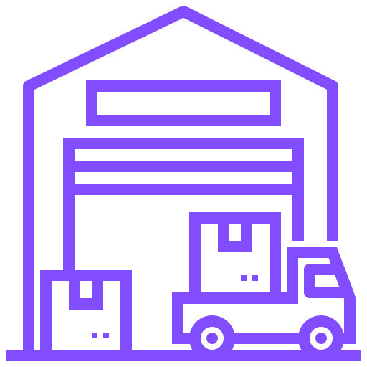
Company Description
Russian chain store and manufacturing company
Supplies goods for office and school, office furniture and equipment, paper and paperboard, plastic package, medical consumables and provides printing services
Large product range
~ 3000 SKU in 50 product groups
Several own factories and warehouses in Russia

Slide 4


Problem Statement
The goal of this project was to optimize the management of office supplies warehouses. It was necessary to:
Provide a convenient search for the desired product by article and its specific location in the warehouse.
Make logging into the system using specific credentials to protect information about products and their features

Slide 5


Possible solutions
Database storing warehouse data
Product search and control
Data security
Warehouse management system
Automated product identification (via barcode or other markings)
Placement strategy assessment
Product search and control
Data security
Examples: mobe3WMS, SphereWMS
WMS

Slide 6

Our Approach
UI
We have made a decision to create supply management system consisting of a UI and a postgres database.
UI can visualize data and allows users with no experience with queries to get data from the database.
This solution is simple and reliable.
Postgres

Slide 7
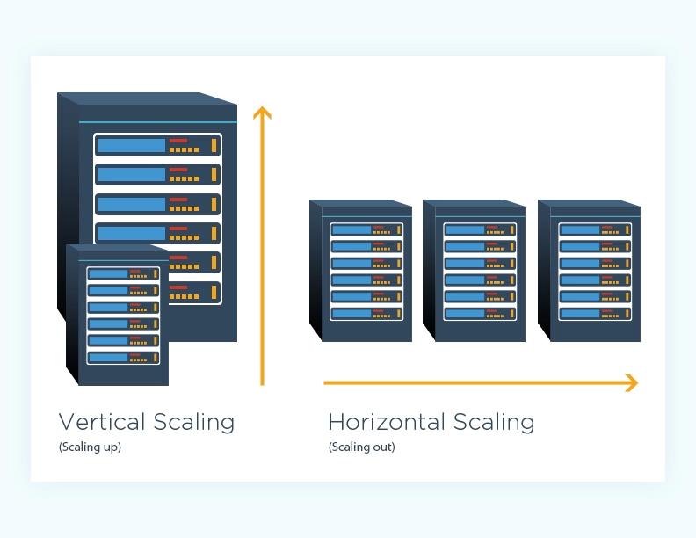
Database Scaling
Vertical scaling keeps your existing infrastructure but adds computing power. Vertical scaling means adding more resources to a single node and scaling spreads the load through CPU and RAM resources for your machines.
Horizontal scaling refers to adding additional nodes or machines to your infrastructure to cope with new demands.
By scaling out, you share the processing power and load balancing across multiple machines

Slide 8
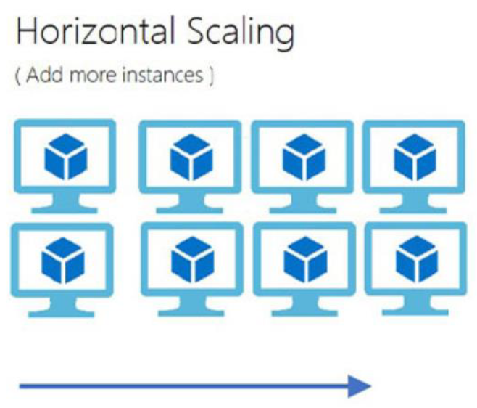
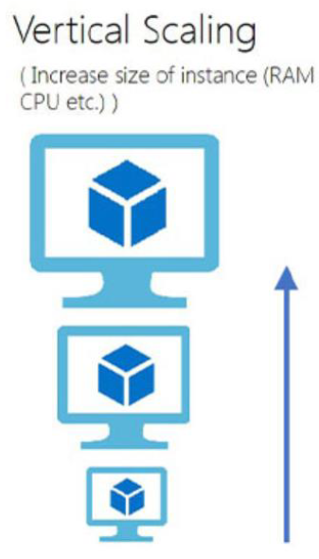
Fact scaling?
Combined scaling:
Vertical: Bigger database = higher power
Horizontal: More requests =more machines
Decision:
Use horizontal scaling for warehouse scaling
Use vertical scaling for increasing number of suppliers and items

Slide 9

Final Result

